Slide 1
JavaScript, DOM and CSS
Week 4 Session1

Slide 2
Contents of This session
JavaScript
DOM ( document object model)
DOM API (application programming interface)
How to use DOM

Slide 3
Document Object Model (DOM)
DOM is a cross-platform and language-independent convention for representing and interacting with objects in HTML, XHTML, and XML documents
The DOM is an API (application programming interface)
It is platform- and language-neutral (accessible in JavaScript, PHP, etc.)
As a data structure, it has a tree-based structure
It is designed to allow programs and scripts to dynamically access and update documents

Slide 4
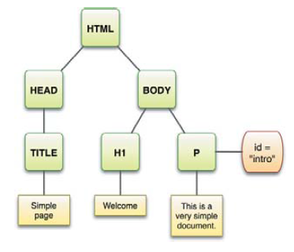
DOM Example – Tree Representation
<!DOCTYPE html PUBLIC "-//W3C//DTD XHTML 1.0 Strict//EN"
"http://www.w3.org/TR/xhtml1/DTD/xhtml1-strict.dtd">
<html>
<head>
<title>Simple page</title>
</head>
<body>
<h1>Welcome</h1>
<p id="intro">This is a very simple document.</p>
</body>
</html>
Tree Representation of HTML

Slide 5
DOM Example
The html element is the parent of the head element and the body element.
The head and body elements are siblings.
The head element is the parent of the title element.
The title element is a child of the head element.

Slide 6
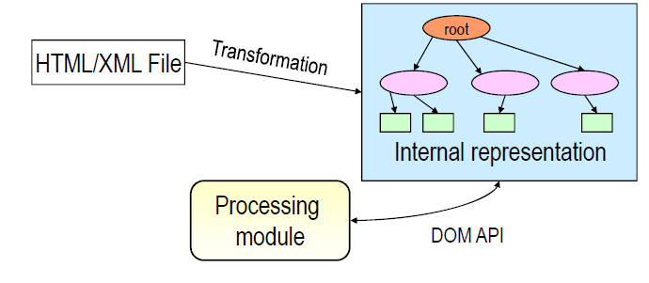
DOM – The Key Concept
Input: An HTML(XHTML)/XML document
Internal representation: An in-memory "tree" data
structure that can be accessed by JavaScript
Access mode: A set of standard API calls

Slide 7
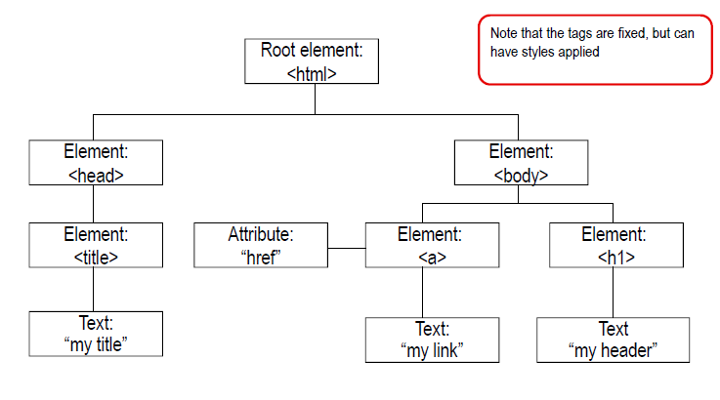
An HTML Tree

Slide 8
XML TREE
<bookstore>
<book category=“computer”>
<title lang=“en”>Everyday Italian</title>
<author>Giada De Laurentis</author>
<year>2005</year>
<price>30.00</price>
</book>
</bookstore>

Slide 9
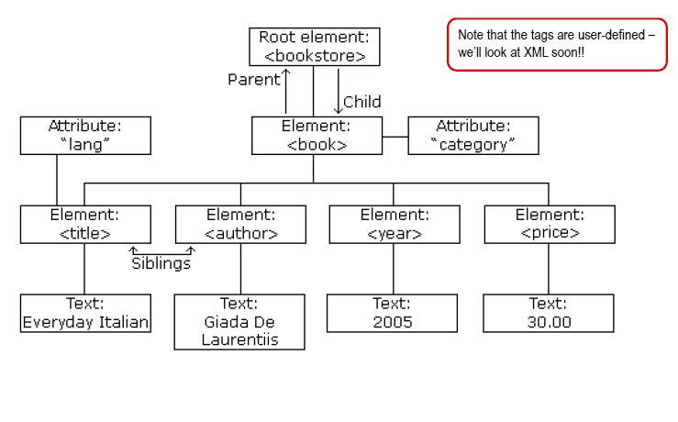
XML TREE

Slide 10
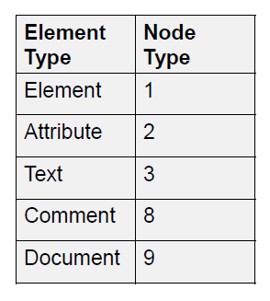
DOM Interfaces
Everything in a document is a node
The entire document is a document node - document
Every HTML tag is an element node
The texts contained in the HTML elements are text nodes
Every HTML attribute is an attribute node
Comments are comment nodes
A Table of Node Type

Slide 11
DOM Interfaces (Cont’d)
A Node Interface is used to read and write the individual elements in the HTML (or XML) node tree.
The childNodes property of an element node (including the documentElement) together with a loop construct can be used to enumerate each individual node for processing.
Main functions of the DOM API
To traverse the node tree
To access and maybe change the nodes and their attribute values
To insert and delete nodes

Slide 12
Document Object Methods
Method | Description
createAttribute(attributeName) | creates an attribute node with the specified attribute name
createElement(tagName) | creates an element with the specified tagName
createTextNode(text) | creates a text node, containing the specified text
getElementsByTagName(tagName) | returns a (node) list of all nodes with the specified tag name
getElementsByName(name) | returns a list of all nodes with the specified name attribute
getElementById(id) | returns the node with the specified id attribute
Example of Document object methods and properties(more on W3schools)

Slide 13
Node Object Properties and Methods
Property | Description
childNodes | returns a NodeList containing all the child nodes for this node
firstChild | returns the first child node for this node
lastChild | returns the last child node for this node
Method | Description
appendChild(newChild) | appends the node newChild at the end of the child nodes for this node
cloneNode(boolean) | returns an exact clone of this node. If the boolean value is set to true, the cloned node contains all the child nodes as well
hasChildNodes() | returns true if this node has any child nodes
Example of Node object methods and properties(more on W3schools)

Slide 14
Style Object Properties
To access a style object from a node object
NodeObject.style
Then you can read/write a property of your choice
Read: NodeObject.style.property_Name;
Write: NodeObject.style.property_Name = Your_Value;
Property | Description
fontSize | sets or returns the font size of the text
backgroundImage | sets or returns the background image of an element
borderStyle | sets or returns the style of an element's border.

Slide 15
Example- Use DOM to update HTML
Toggle Border and Background
Create and add a new element to a page
Dynamically change the text style
Hide the content or display content

Slide 16
Exercise
JavaScript Dom exercise

Slide 17
End of The Session 1
Week 4

